Slide 1
Digital Circuit Design and Analysis
115-1
Syllabus
Chung-An Shen(沈中安)
Department of Electronic and Computer Engineering
National Taiwan University of Science and Technology
Notes:
Time Table:
Slide 1 to 6 5min
Slide 7-9 4min
Slide 10-12 5min
Slide 13 1min

Slide 2
Course Administrations
Time/Venue: Friday 1:20 AM – 4:20PM @ IB 602-2
Instructor: Chung-An Shen (沈中安), Professor
Department of Electronic and Computer Engineering, NTUST
email: cashen@mail.ntust.edu.tw ; office: IB 714-1
office hours: 8:30AM-10:10AM, Tuesday or appoint via email
TA: 李威辳 M11402117@mail.ntust.edu.tw
Grading : Test (9/18/2026) 10%
Project 1 (Due 10/16/2026): 25%
Project 2 (Due 11/20/2026): 35%
Final Project (Due 12/25/2026): 40%

Slide 3
Project 1 and Project 2
Two Students per Group
The Contest of Digital IC Design and Implementation (教育部積體電路設計競賽)
You need to have the EDA environment setup to work on the projects.
Project 1: Post-synthesis results.
Project 2: Post-layout results
Grading Policy | Score (out of 100)
Top 1st place of Performance Metric | A+ (95)
Top 2nd ~ 3rd place of Performance Metric | A (87)
Top 4th ~ 5th place of Performance Metric | A- (82)
Others | B+ (78) or below
Performance Metric = Time Complexity × Area Complexity

Slide 4
Final Project
Two Students per Group
Pick your own topic and performance target.
  High throughput, low latency, low complexity, low power, or others.
You need to design and implementation the circuit, as well as clearly illustrate the approaches you use to achieve your performance target.
Post-layout results + “tape-out ready” + Performance improvement
You need to have the EDA environment to work on the projects.

Slide 5
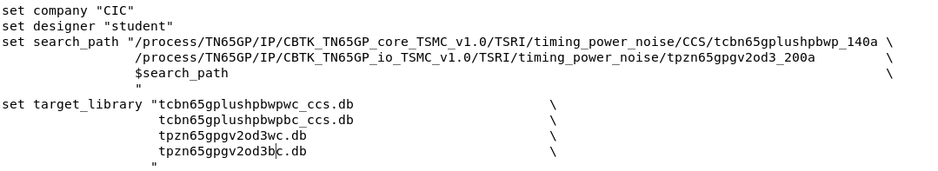
Projects Process
TSRI (65 nm)

Slide 6
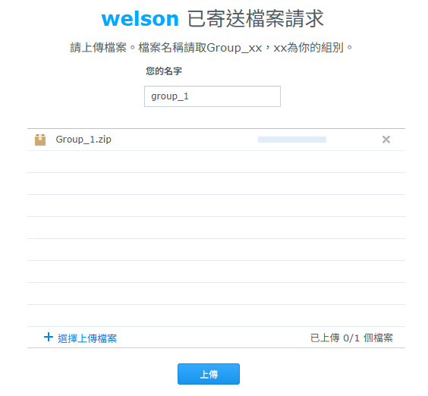
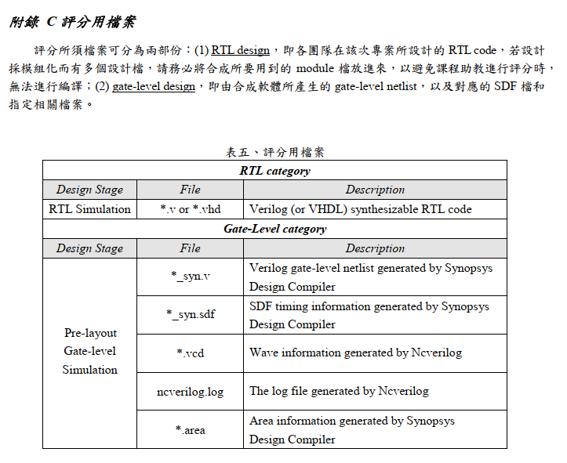

Upload File of Project I
上傳密碼:
DVLSI11501
Group list: Group_list.xlsx
Upload URL: Upload_your_design_Project1
Upload URL: Upload_your_design_Project2
Upload file: group_xx.tar or .tar.gz or .zip
先到共用表單登記組別!
Upload your Project I !
Upload your Project II !
*DC .tcl

Slide 7
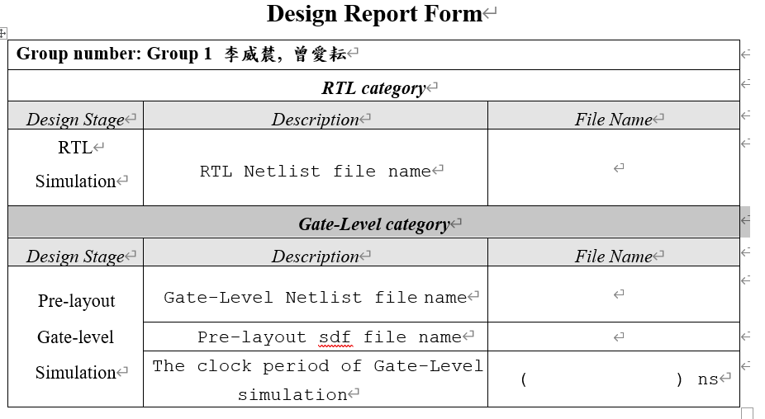
Design Report Form

Slide 8
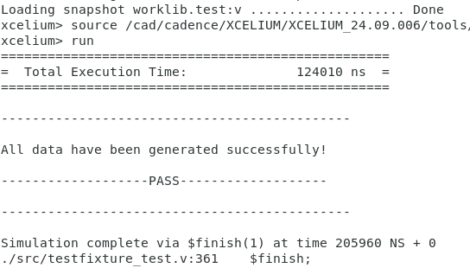
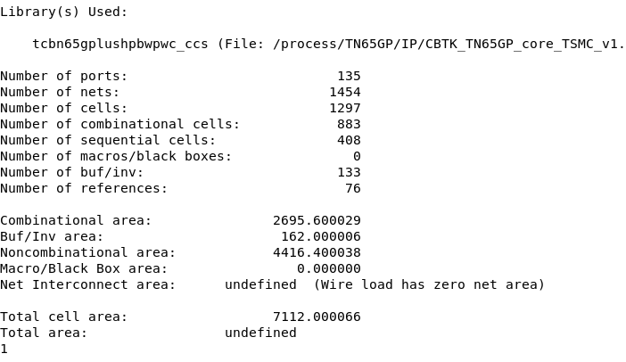
Project 1 評分標準
Performance Metric = Time Complexity × Area Complexity
Time Complexity範例
Area Complexity範例

Slide 9
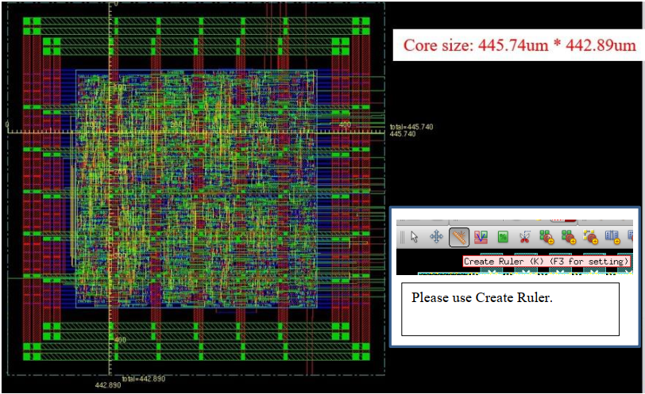
Project 2 評分標準
Performance Metric = Time Complexity × Area Complexity
Layout 尺規量測圖

Slide 10



